Slide 1
A Comprehensive Data-Driven Study of the COVID-19 Pandemic
Big Data Final Presentation
Authors:
Weiyi Luo (WL3398)
Jia Yang (JY5081)
Geng Niu (GN2279)

Slide 2
CONTENTS
1. Executive Summary
2. Problem Statement and Objectives
3. Dataset Description
4. System Architecture and Technology Stack
5. Data Preprocessing & Warehouse Design
6. Hive Processing Pipeline
7.Spark Analytics Pipeline
8. Results & Analysis
9. Technical Challenges
10. Changes in Technology
11. Lessons Learned
12. Future Improvements

Slide 3
1. Executive Summary
We processed the 379k-record OWID COVID-19 dataset using an end-to-end big data pipeline built with Hadoop HDFS, Hive, and Spark.
A three-layer data warehouse (ODS → DWD → DWS) was designed to clean, standardize, and aggregate large-scale pandemic indicators.
Spark and Python visualization workflows were developed to answer eight analytical research questions, covering trends, vaccination effects, testing capacity, income disparities, and policy effectiveness.
Our system demonstrates how distributed data engineering + analytical modeling can generate clear insights into global COVID-19 patterns.

Slide 4
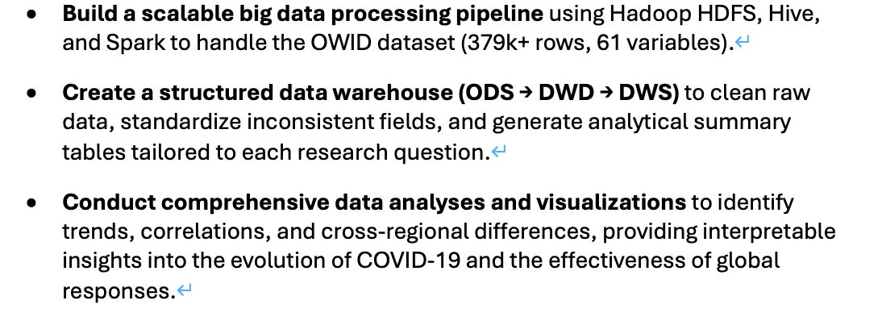



2. Problem Statement and Objectives
The pandemic produced large-scale heterogeneous data that requires structured big-data tools to extract meaningful insights.
Our goal is to answer eight research questions covering trends, vaccination, testing, socioeconomic factors, and policy effectiveness.
We built a scalable warehouse and visualization workflow to support systematic analysis.

Slide 5
3. Dataset Description
Dataset Structure Overview
Category | Key Variables | Purpose
🦠 Epidemiological Indicators | total_cases, new_cases, total_deaths, new_deaths, new_cases_per_million | Track outbreak severity and daily transmission levels.
💉 Vaccination Data | people_vaccinated, people_fully_vaccinated, people_vaccinated_per_hundred, total_vaccinations | Measure vaccination rollout and evaluate its impact on cases and mortality.
🔬 Testing & Positivity Statistics | total_tests, new_tests, positive_rate, tests_per_case | Assess testing capacity and infection detection accuracy.
🏛️ Policy Response Indicators | stringency_index, reproduction_rate | Analyze government restrictions and their effect on transmission.
👥 Demographic & Socioeconomic Variables | population, median_age, gdp_per_capita, human_development_index | Explain cross-country differences in infection, mortality, and recovery.
🌍 Geographic Fields | iso_code, location, continent, date | Identify regions and align all time-series records.

Slide 6

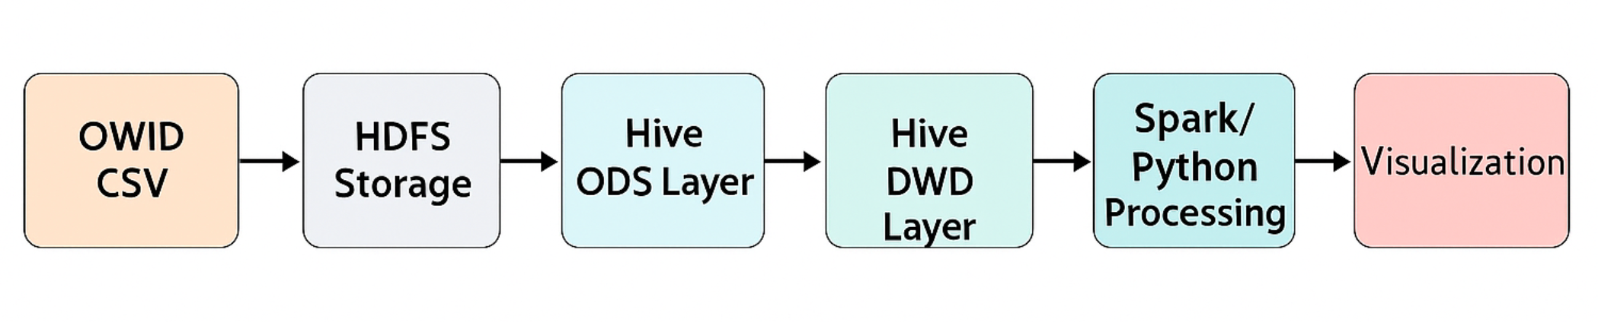
4. System Architecture and Technology Stack
Our architecture follows: CSV → HDFS → Hive ODS/DWD/DWS → Spark/Python → Visualization
Hive provides structured data management, while Spark supports fast analytical processing.
Python ensures flexible and clear visualization for all research questions.

Slide 7

5. Data Preprocessing & Warehouse Design
ODS stores raw STRING-type data exactly as provided by OWID.
DWD performs cleaning, type casting, partitioning, and standardization.
DWS aggregates metrics into four analytical tables used directly for Spark visualization.

Slide 8
6. Hive Processing Pipeline
Hive ingests raw data into ODS, converts and partitions it in DWD, and produces analytical tables in DWS.
All DWS tables were exported as CSV to support Spark-based visualizations.
This pipeline ensures consistent, efficient preparation for all analytical tasks.

Slide 9
7.Spark Analytics Pipeline
Spark loads DWS tables, selects subsets for each research question, and prepares cleaned DataFrames.
Additional filtering, grouping, and formatting steps support accurate interpretations.
Visualizations are generated using matplotlib to present trends and relationships clearly.

Slide 10




8. Results & Analysis
RQ1: How did COVID-19 cases and deaths evolve across continents over time?
RQ2: Which countries experienced the highest infection rates and mortality ratios?
RQ3: How do vaccination rates relate to new COVID-19 cases and deaths?
RQ4: How do vaccination progress and pandemic recovery differ across regions?
RQ5: What do the global time-series patterns of new cases, deaths, and vaccinations look like?
RQ6: How has testing capacity influenced case detection and positivity rates?
RQ7: What are the differences in COVID-19 outcomes between high-income and low-income countries?
RQ8: How is policy strictness related to changes in daily COVID-19 cases?

Slide 11
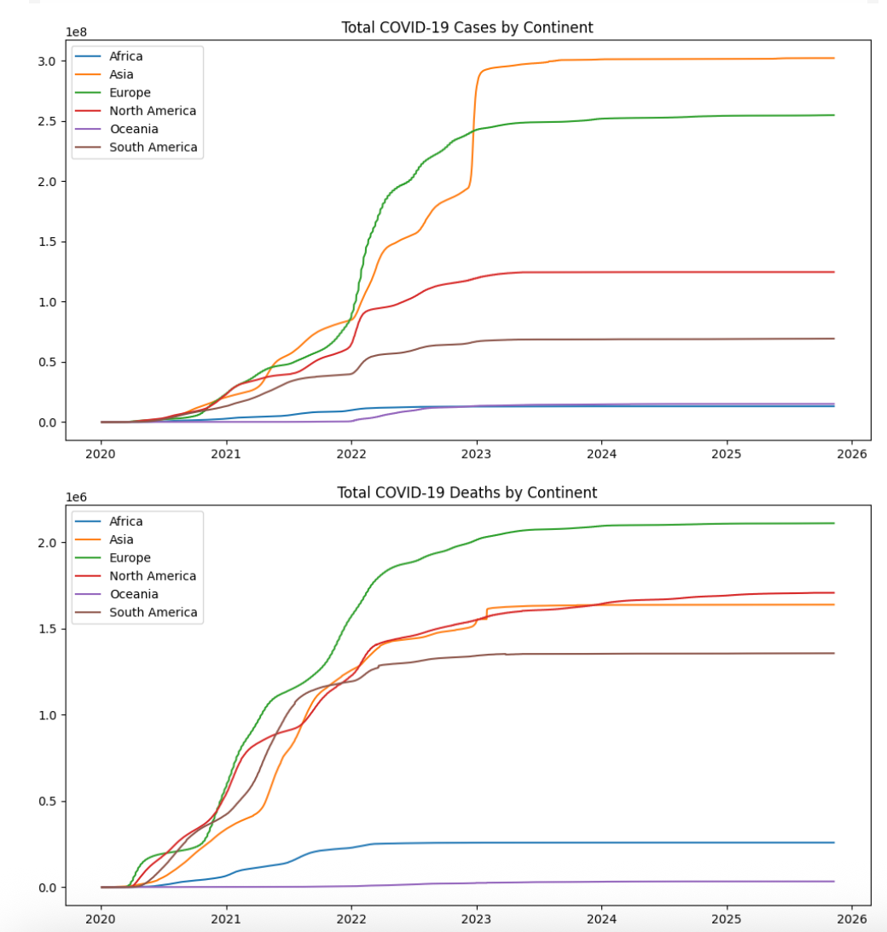
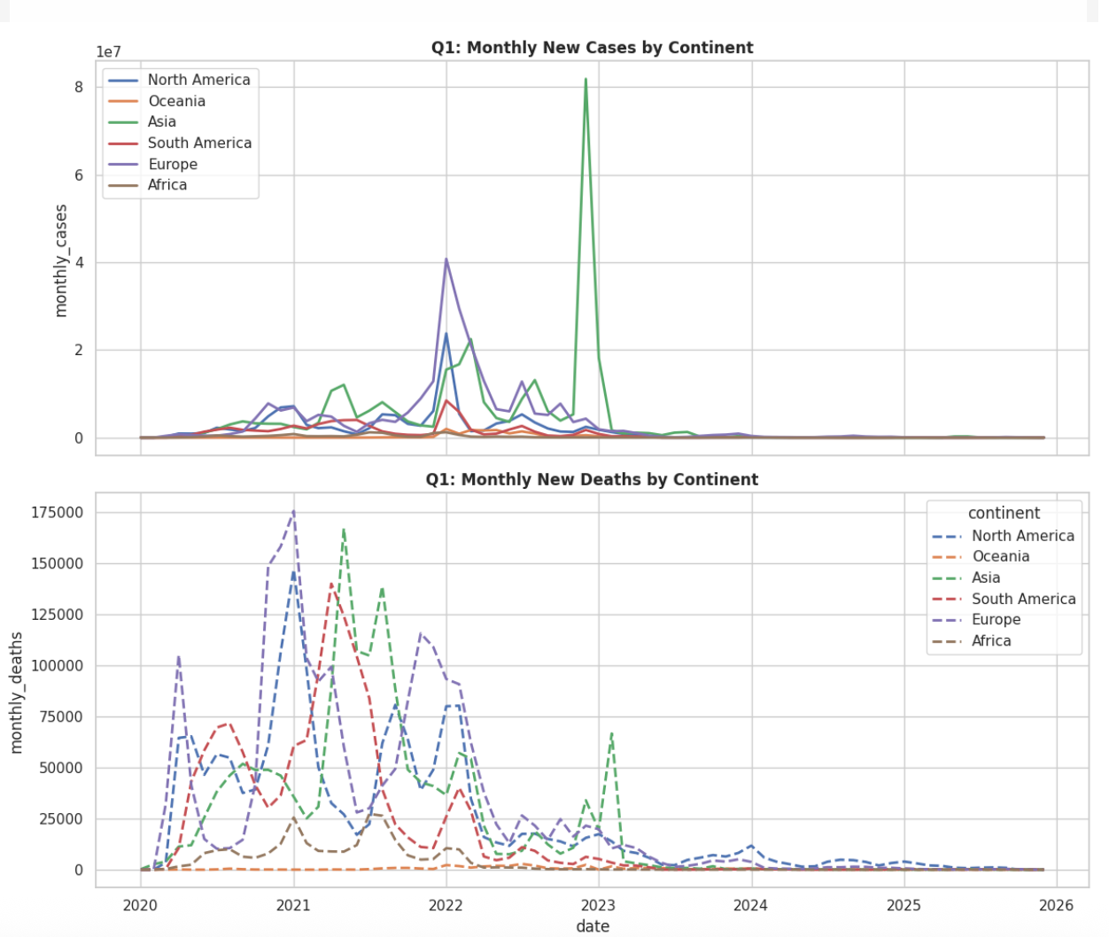
RQ1: How did COVID-19 cases and deaths evolve across continents over time?

Slide 12
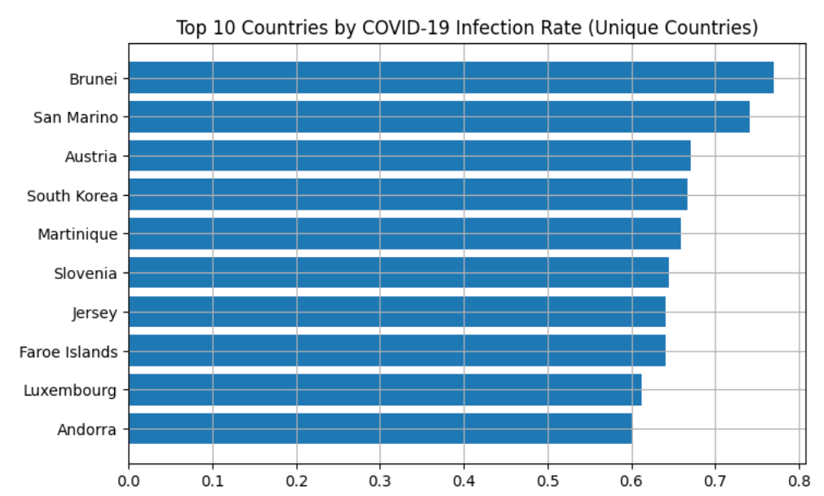
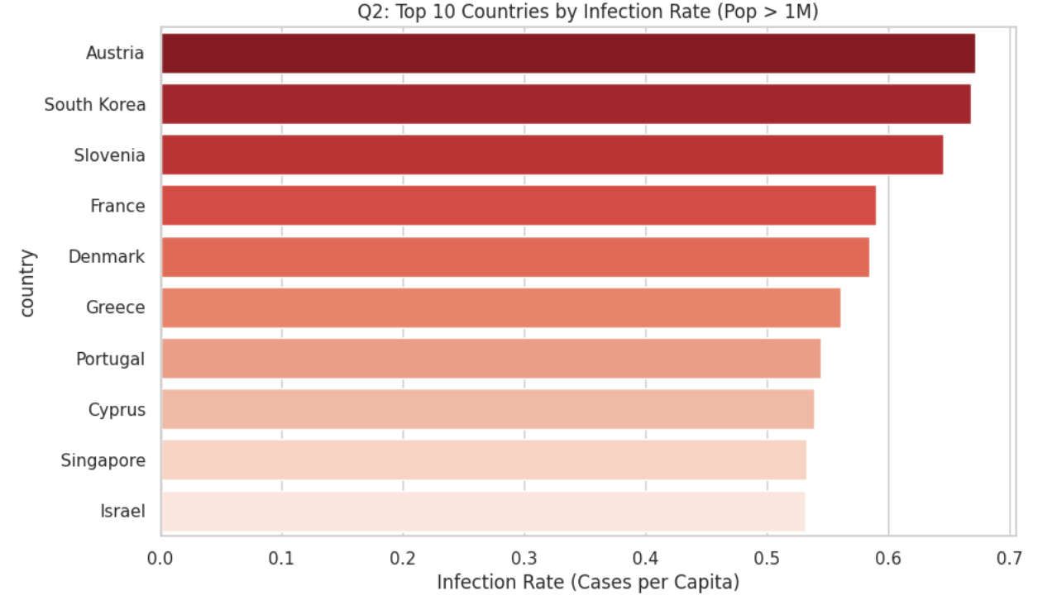
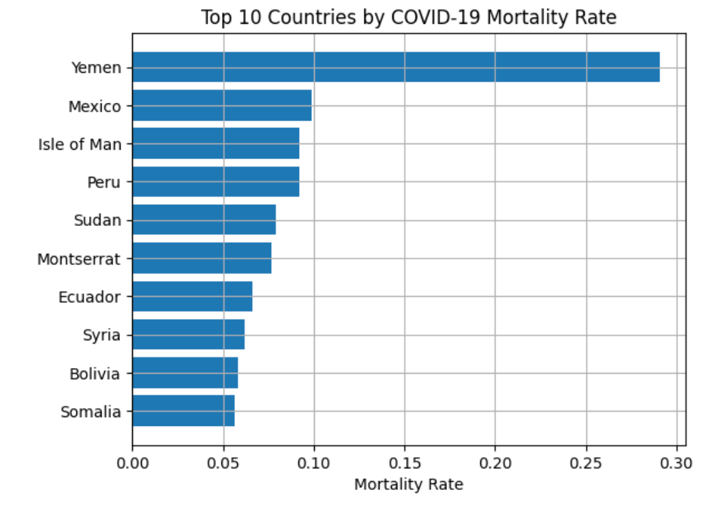
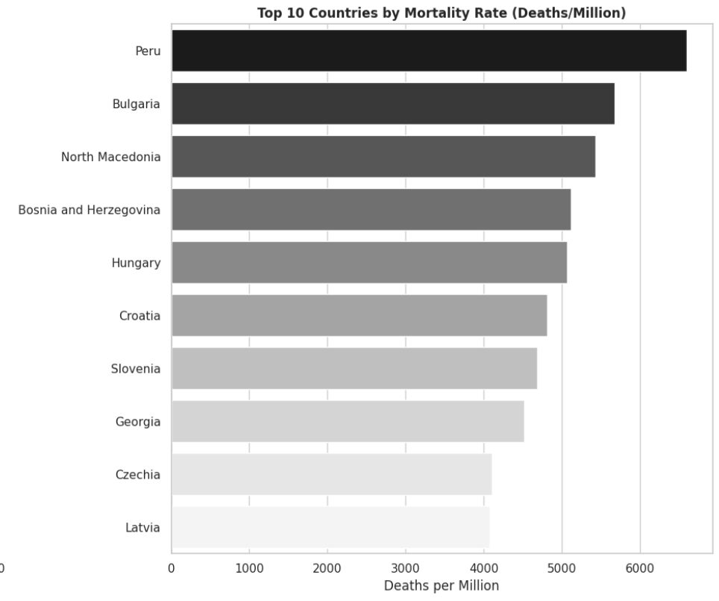
RQ2: Which countries experienced the highest infection rates and mortality ratios?

Slide 13
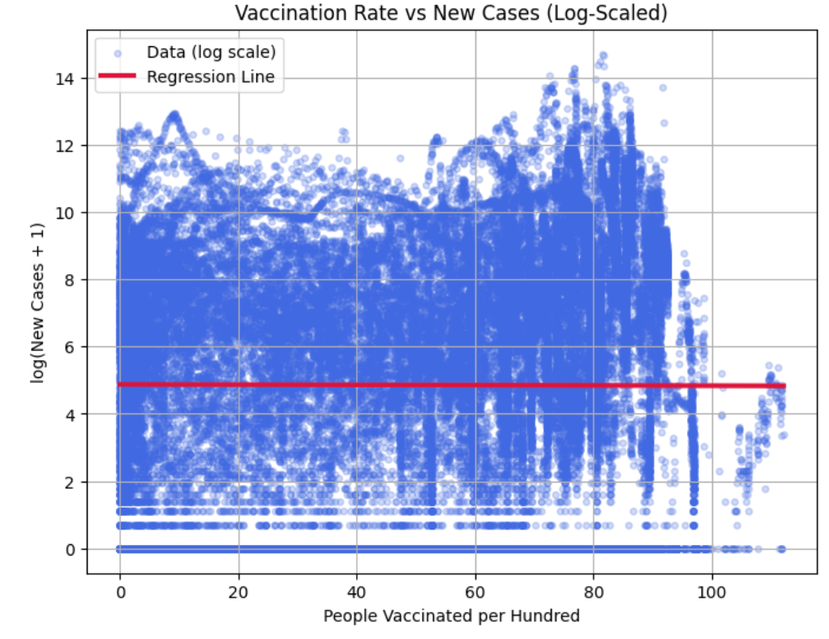
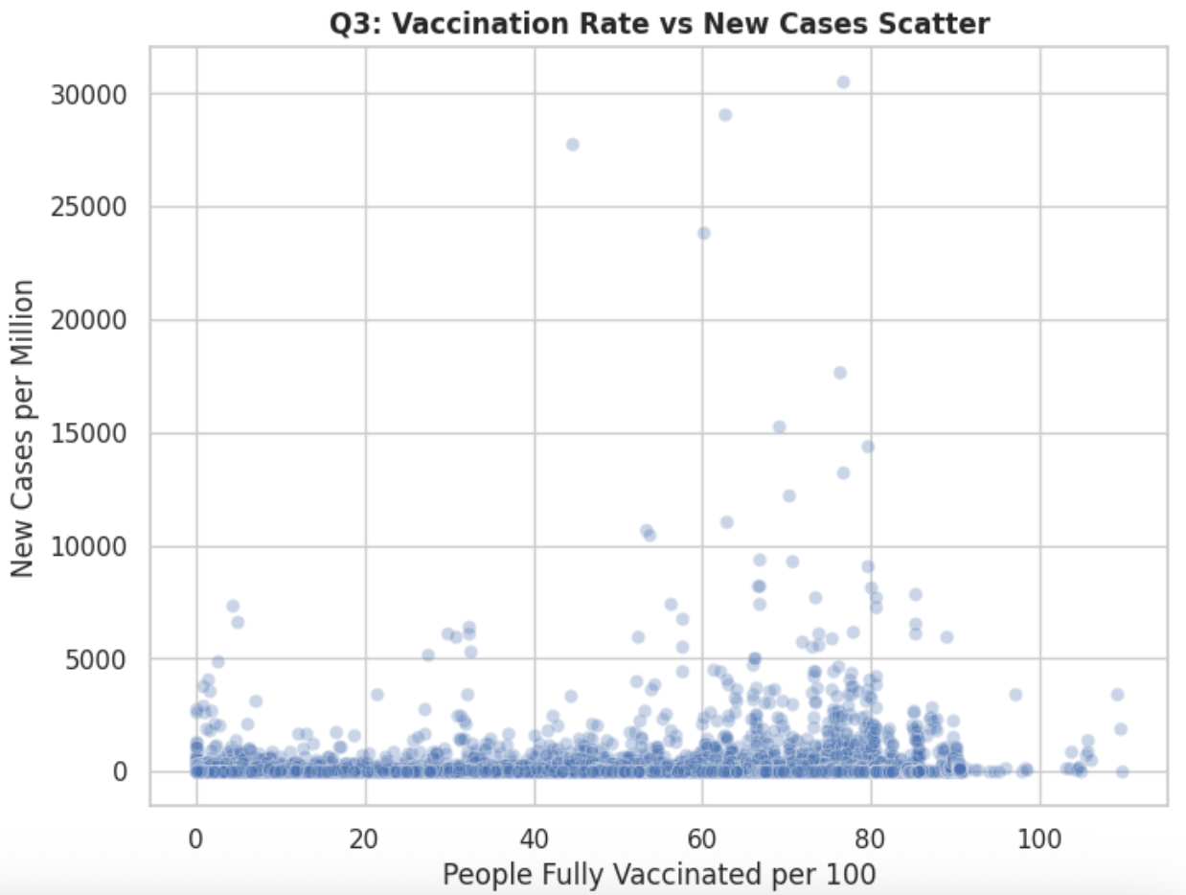
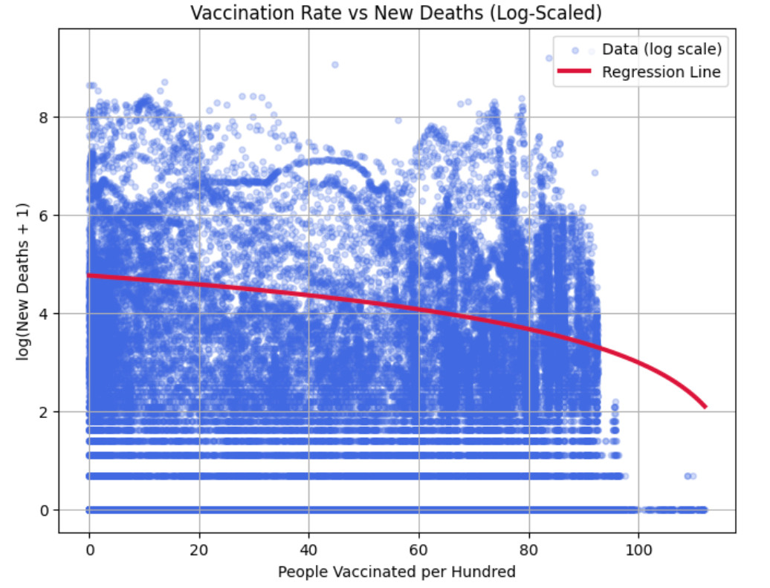
RQ3: How do vaccination rates relate to new COVID-19 cases and deaths?

Slide 14
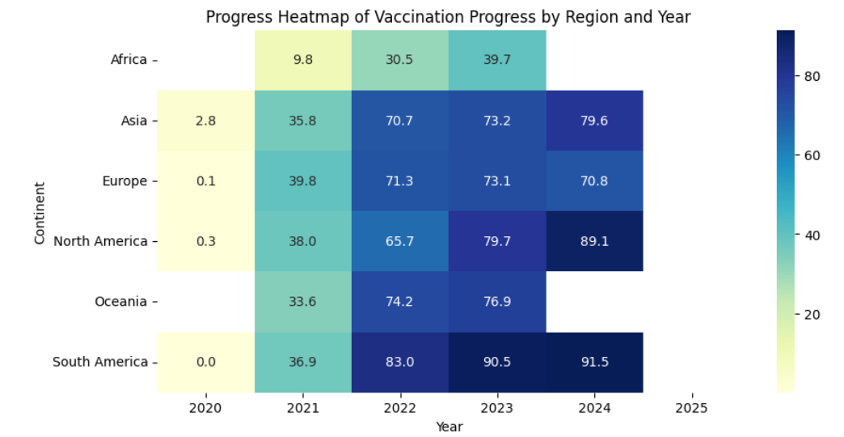
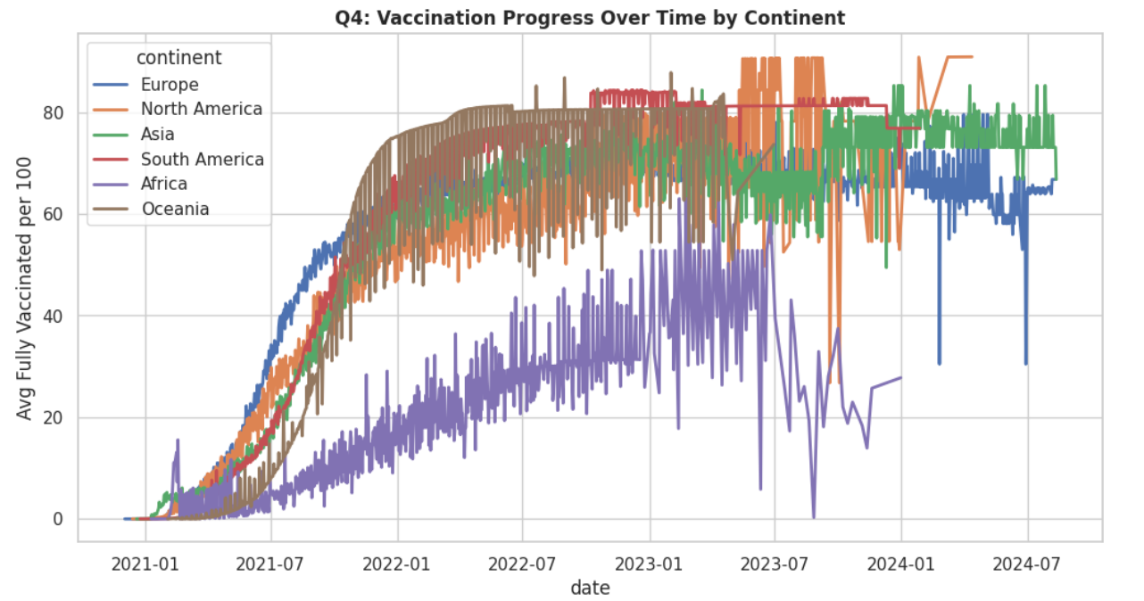
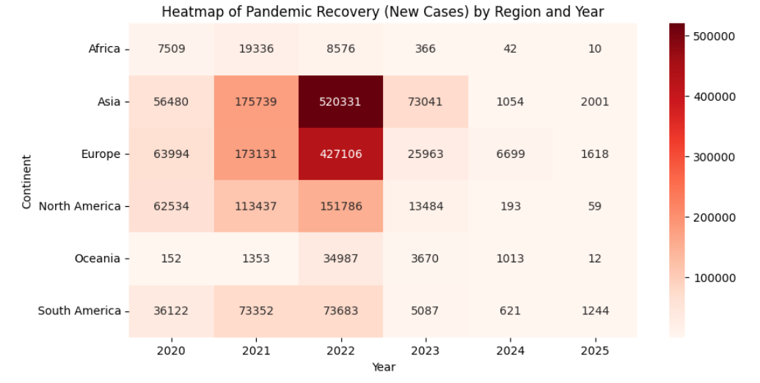
RQ4: How do vaccination progress and pandemic recovery differ across regions?

Slide 15
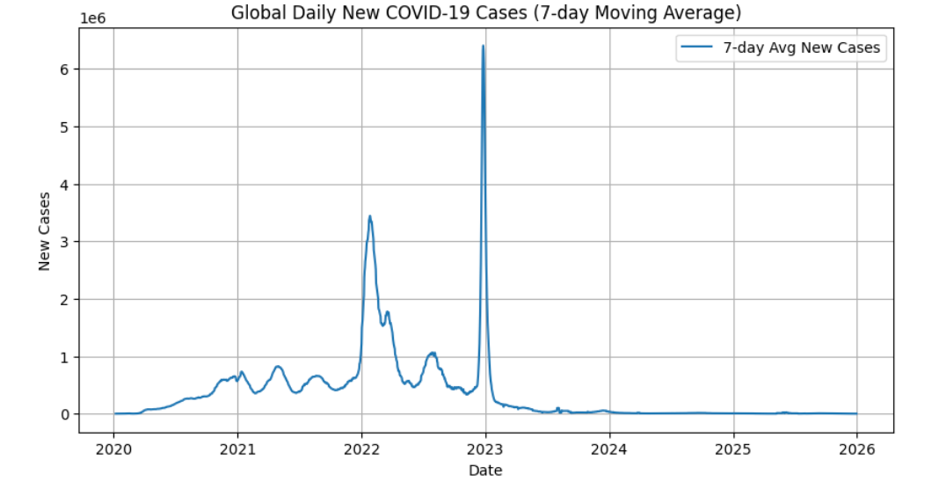
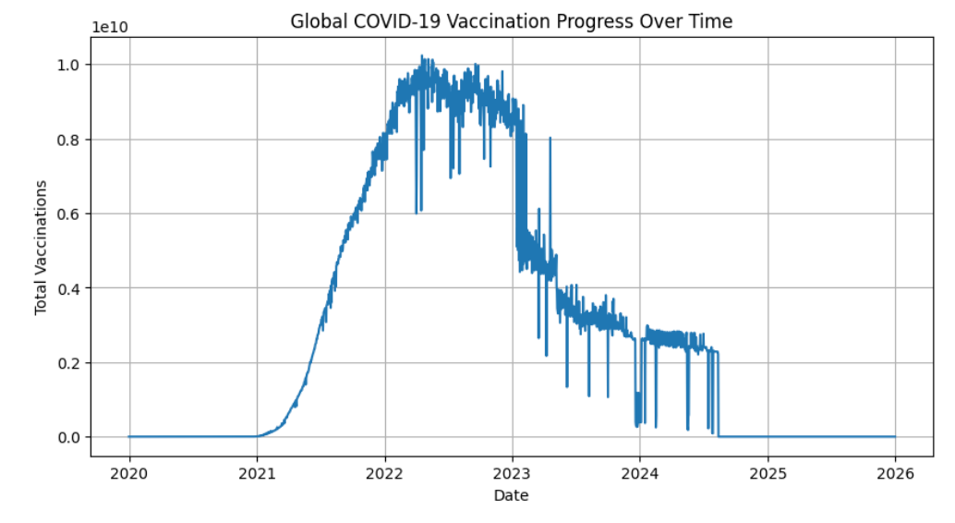
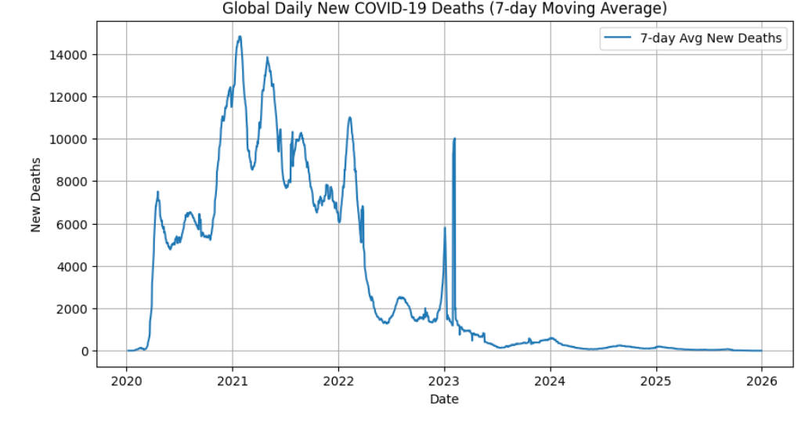
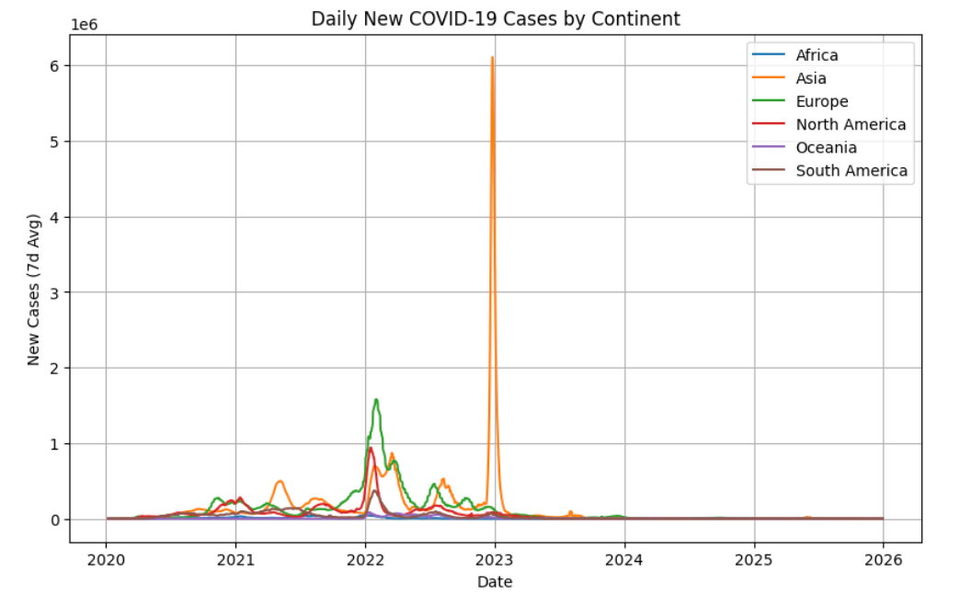
RQ5: What do the global time-series patterns of new cases, deaths, and vaccinations look like?

Slide 16
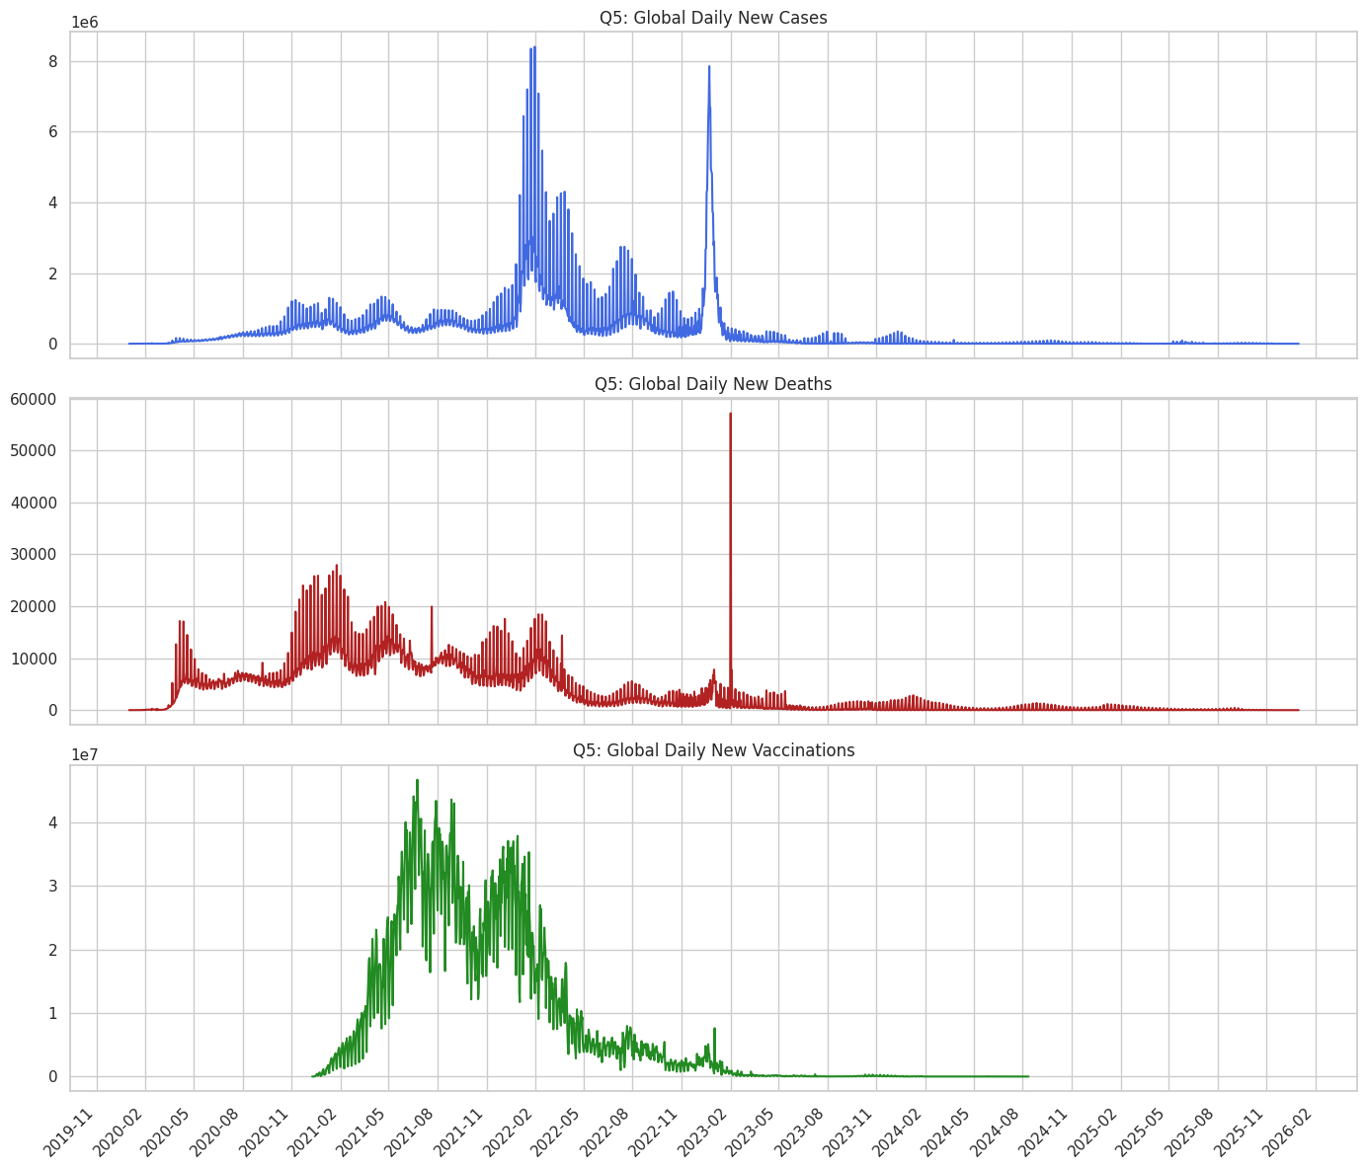
RQ5: What do the global time-series patterns of new cases, deaths, and vaccinations look like?

Slide 17
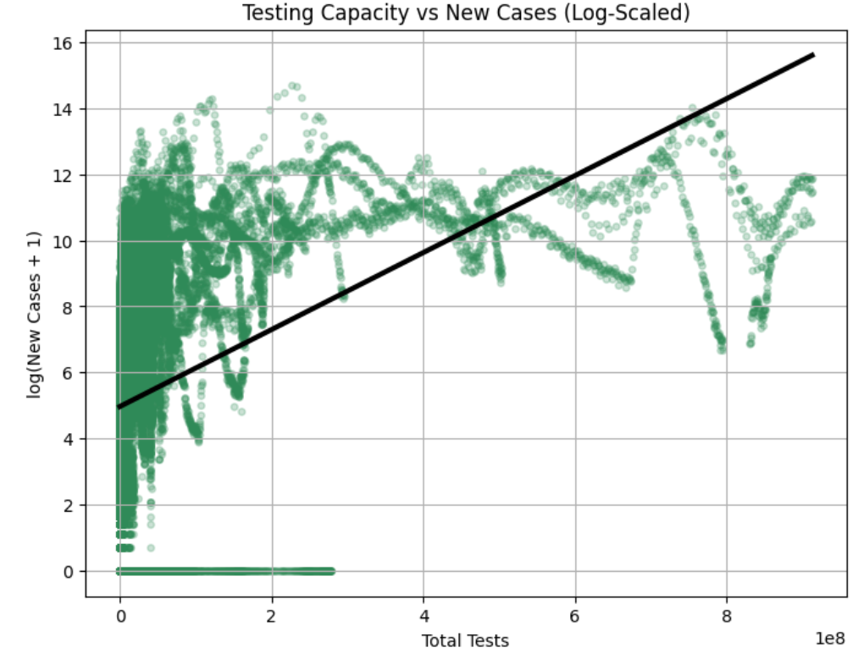
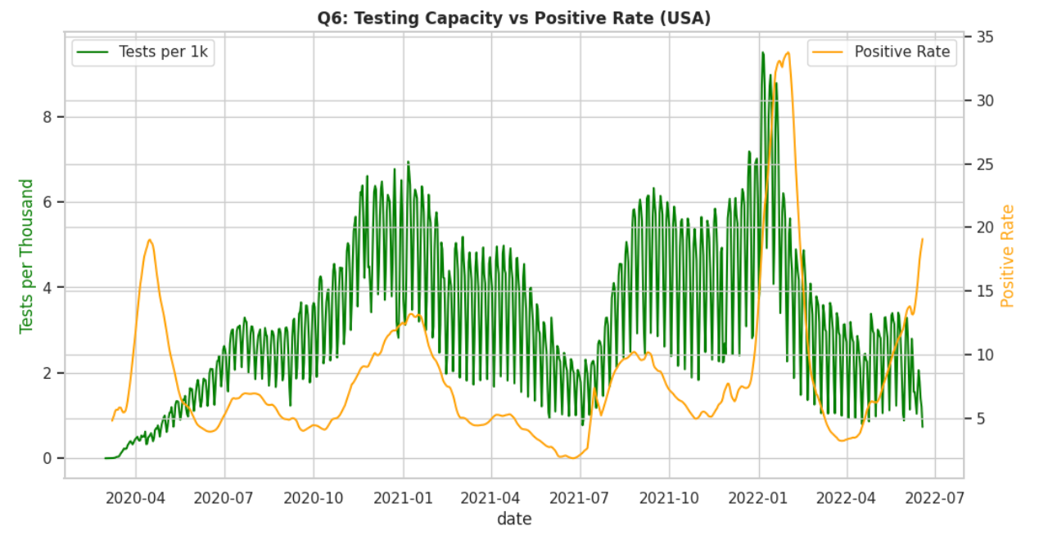
RQ6: How has testing capacity influenced case detection and positivity rates?

Slide 18
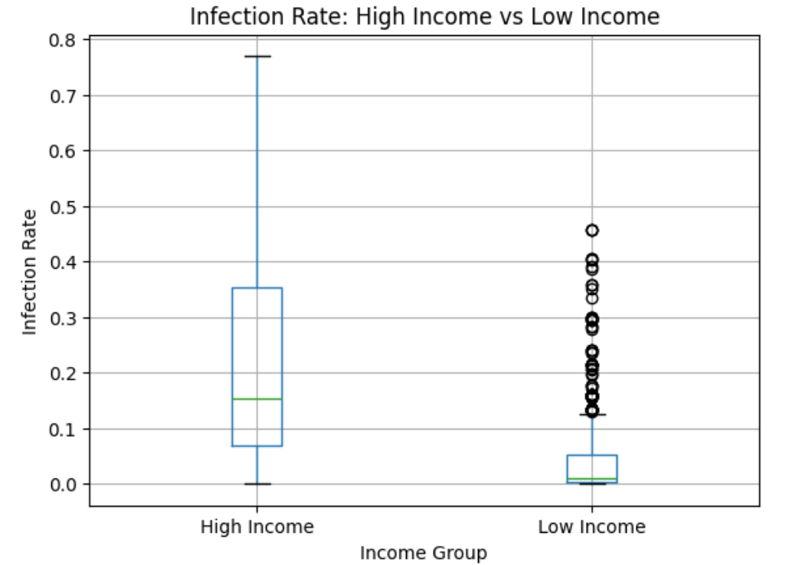
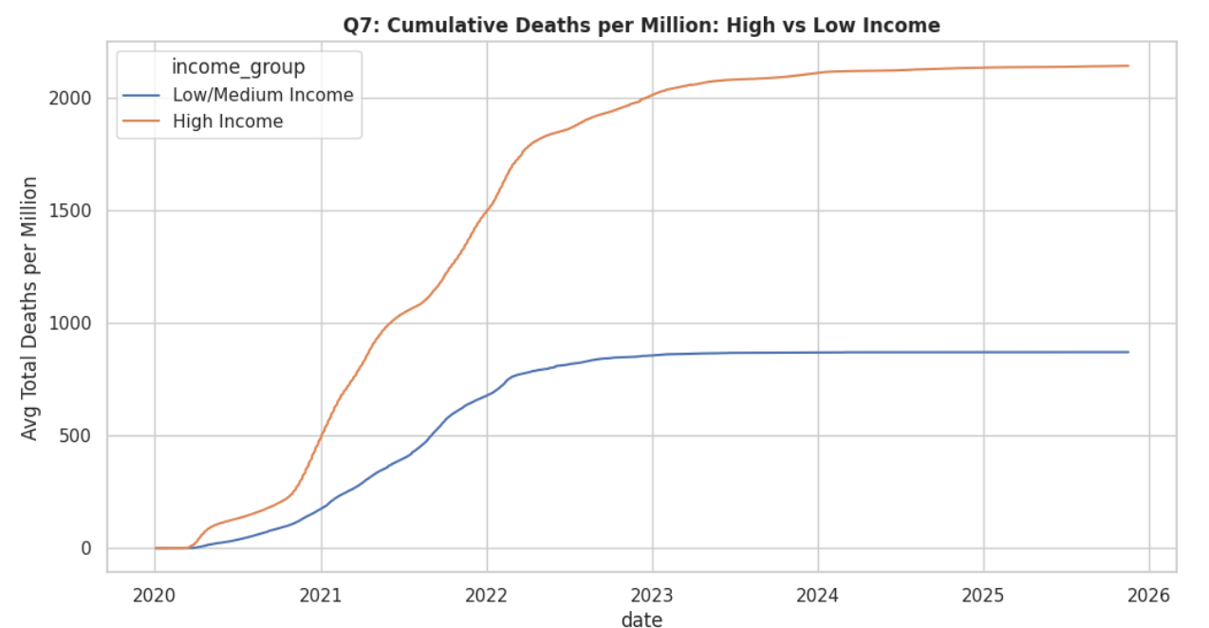
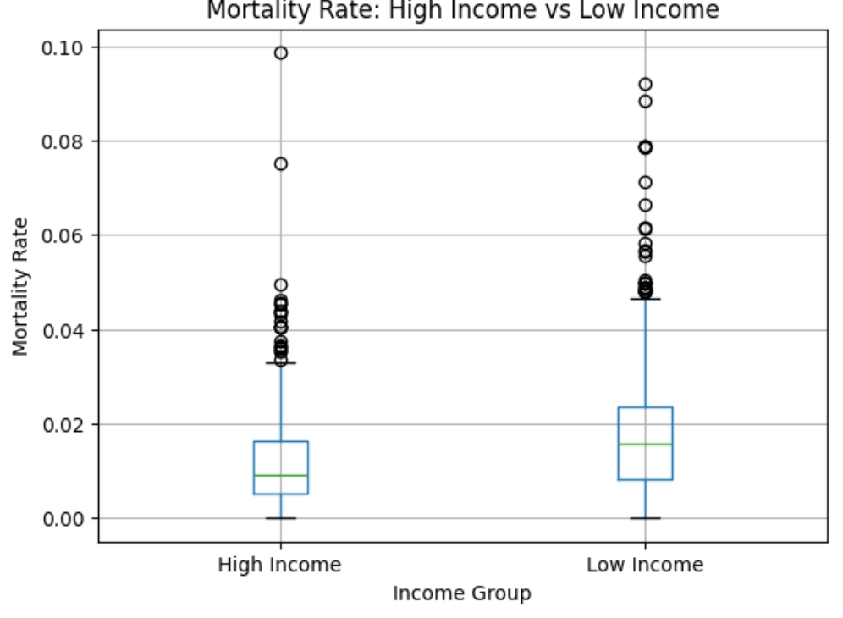
RQ7: What are the differences in COVID-19 outcomes between high-income and low-income countries?

Slide 19
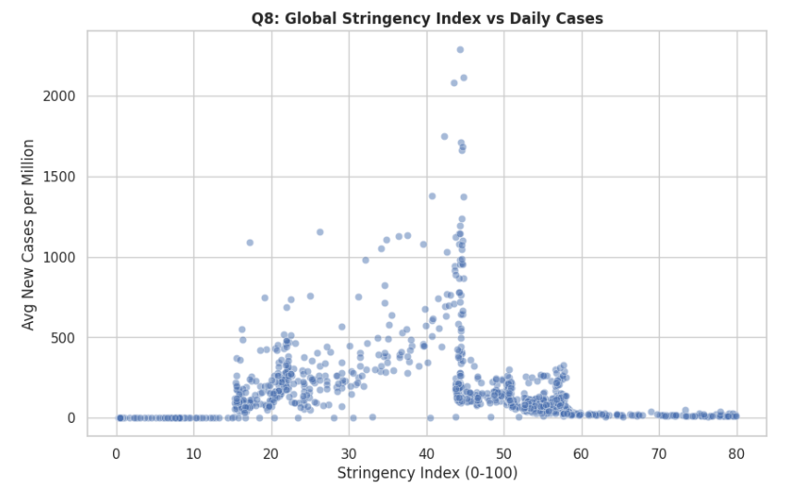
RQ8: How is policy strictness related to changes in daily COVID-19 cases?

Slide 20







9. Technical Challenges
Dynamic partition issues in Hive required repeated schema and configuration adjustments.
Missing and inconsistent OWID fields required substantial preprocessing.
Large window functions slowed Spark operations, pushing more computation into Hive.

Slide 21


10. Changes in Technology
More aggregation and window logic were moved from Spark to Hive for efficiency.
Planned predictive components were removed due to data quality and time constraints.
Visualization shifted partly to Python for greater flexibility.

Slide 22





11. Lessons Learned
Data quality challenges significantly influence pipeline design and analysis accuracy.
Pre-aggregation in Hive improves performance and reduces Spark workload.
Visualization depends heavily on consistent, well-cleaned inputs.

Slide 23

12. Future Improvements
Integrating predictive modeling could extend descriptive results into forecasting.
Automated ETL workflows would make the pipeline more scalable and maintainable.
Additional datasets (mobility, hospitalization, variants) could deepen insights.

Slide 24
THE END
THANKS

